Slide 1

BizEasy: Your Smart Business Partner
See how BizEasy makes your daily tasks and workflows easy and smooth.
Presented by: Muhammed Anas M A
MCA Third Semester Mini Project
Project Guide: MUHSIN SIR

Slide 2

Introducing BizEasy: Making Business Transactions Simple
BizEasy is an easy-to-use web app that helps you handle your main business tasks smoothly.
Web-Based Accounting
Simple Billing
A strong tool you can use from anywhere. It keeps your financial data always up-to-date and correct.
Easily create professional invoices and manage customer payments with a clear and simple design.
Easy Management
Get full control over your products, invoices, and money matters with strong organizing tools.

Slide 3


Main Features of BizEasy
BizEasy gives you all the tools your business needs to work better, no matter its size.
Safe User Login
A strong login system with different roles for Admin and Staff, keeping your data safe and access controlled.
Easy Product Management
Keep track of your products easily with clear groups and sub-groups for simple checking and updates.
Automatic Billing
Quickly make and change invoices, saving time, reducing mistakes, and making transactions faster.
Live Money Tracking
Watch your income and costs automatically, giving you a clear and current look at your money.
Useful Reports
Strong tools for sorting and reporting data that give you helpful ideas for making smart business choices.
BIZEASY

Slide 4


How Roles Work: Owner vs. Staff
BizEasy changes what people can do based on their job, making things safer and work better.
What Owners Can Do
What Staff Can Do
Full control over products, bills, and accounts.
Mostly limited to the billing section.
Can add, change, and remove all transactions.
Can create and view bills, but can't change main settings.
Can see all reports and important information.
Can only view product and discount details.
BIZEASY

Slide 5


Problems with Old Ways
Doing things by hand is often slow, causes mistakes, and isn't fast enough for today's businesses.
Writing Things Down by Hand
Many Chances for Mistakes
Slow to See How Things Are Doing
People make mistakes when typing in numbers by hand, which leads to wrong financial records and stock counts.
Using paper books and ledgers to keep records is hard, slow, and things can easily get lost.
It's hard to quickly know how much stock you have or how well sales are going, which makes it tough to make smart business choices on time.
BIZEASY

Slide 6
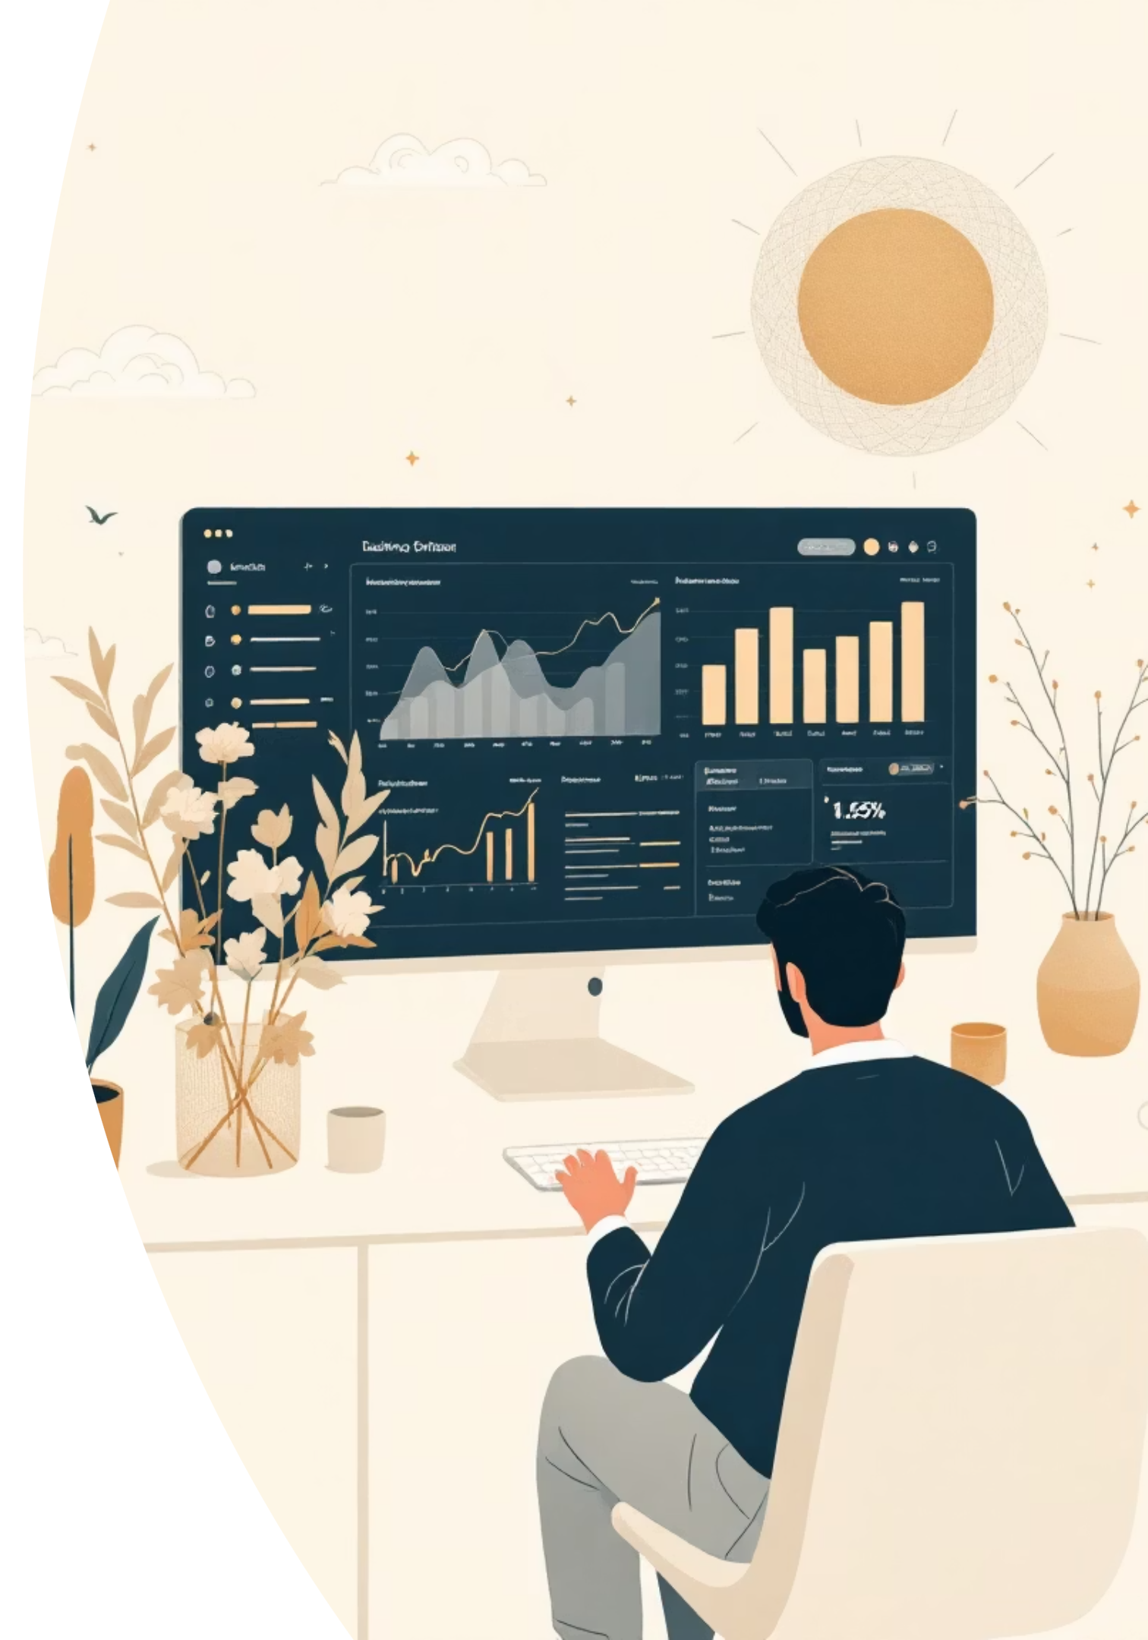
BizEasy: The Solution for Modern Business
Our system changes old problems into easy digital ways, making things work faster and helping you understand your business better.
Instant Business Overview
See your current stock, sales, and money details right away, from anywhere, anytime.
Quick & Correct Bill Creation
Make good-looking bills very quickly and correctly, making customers much happier and cutting down on waiting time.

Slide 7





The Technology Powering BizEasy
BizEasy is built upon a robust and modern tech stack, ensuring reliability, scalability, and an optimal user experience.
Backend: Python (Django)
Frontend: HTML, CSS, JS, Ajax
A powerful and secure framework handling server-side logic, data processing, and API management.
Interactive and dynamic user interfaces for a seamless, responsive, and engaging user experience.
Database: SQLite
UI Styling: Bootstrap
A lightweight and reliable relational database for efficient and secure data storage and retrieval.
A leading framework ensuring responsive, elegant design for a consistent and attractive interface across devices.
BIZEASY

Slide 8
BizEasy Benefits: What Makes It Great
BizEasy has many good points that help your business work better and stay strong.
1
2
3
Easy-to-Use Design
Fewer Mistakes
Works for Many Users
It's simple to find your way around and do your work, so everyone can learn it quickly.
It does the math for you and checks your data, greatly cutting down on common accounting errors.
Different team members can use it with their own access levels, helping everyone work well together.
4
5
Saves Time with Automation
Clear Facts & Reports
It makes everyday office jobs faster, so your team can focus on growing the business.
You get easy-to-read reports that help you make smart choices based on real numbers.
BIZEASY

Slide 9


Conclusion: Making Your Business Easy with BizEasy
BizEasy helps your business run smoothly and clearly, giving you full control.
Smart Management
Changes hard business tasks into simple ones, making things less stressful and helping you focus more.
Easy Transactions
Makes sure billing is smooth and records are always right, building trust and dependability.
Get ready for an easier way to run your business with a solution that's truly easy, fast, and smart.

Slide 10

Thank You
Questions? Feedback?
BIZEASY

